Slide 1

Introduction to JavaScript Development
http://academy.telerik.com
The Magic of Dynamic Web Pages
JavaScript Fundamentals
Telerik Software Academy
http://academy.telerik.com

Slide 2

Table of Contents
Dynamic HTML
How to Create DHTML?
XHTML, CSS, JavaScript, DOM
Intro to JavaScript
JavaScript in Web Pages
JavaScript Syntax
Pop-up boxes
Debugging in JavaScript

Slide 3


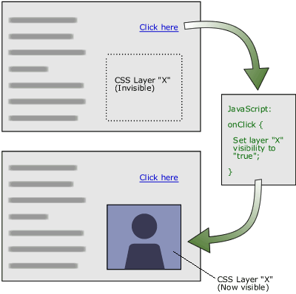
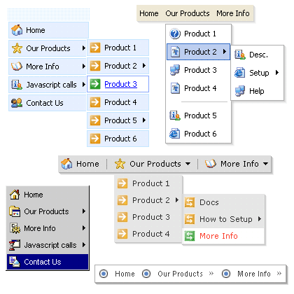
Dynamic HTML
Dynamic Behavior at the Client Side

Slide 4
What is DHTML?
Dynamic HTML (DHTML)
Makes possible a Web page to react and change in response to the user’s actions
DHTML consists of HTML + CSS + JavaScript
DHTML
XHTML
CSS
JavaScript
DOM

Slide 5
DTHML = HTML + CSS + JavaScript
HTML defines Web sites content through semantic tags (headings, paragraphs, lists, …)
CSS defines 'rules' or 'styles' for presenting every aspect of an HTML document
Font (family, size, color, weight, etc.)
Background (color, image, position, repeat)
Position and layout (of any object on the page)
JavaScript defines dynamic behavior
Programming logic for interaction with the user, to handle events, etc.

Slide 6
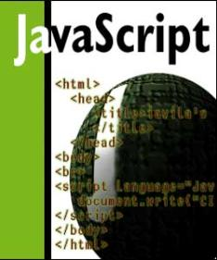


JavaScript
Dynamic Behavior in a Web Page

Slide 7
JavaScript
JavaScript is a front-end scripting language developed by Netscape for dynamic content
Lightweight, but with limited capabilities
Can be used as object-oriented language
Embedded in your HTML page
Interpreted by the Web browser
Client-side, mobile and desktop technology
Simple and flexible
Powerful to manipulate the DOM

Slide 8
JavaScript Advantages
JavaScript allows interactivity such as:
Implementing form validation
React to user actions, e.g. handle keys
Changing an image on moving mouse over it
Sections of a page appearing and disappearing
Content loading and changing dynamically
Performing complex calculations
Custom HTML controls, e.g. scrollable table
Implementing AJAX functionality

Slide 9
What Can JavaScript Do?
Can handle events
Can read and write HTML elements and modify the DOM tree
Can validate form data
Can access / modify browser cookies
Can detect the user’s browser and OS
Can be used as object-oriented language
Can handle exceptions
Can perform asynchronous server calls (AJAX)

Slide 10
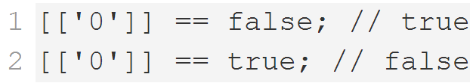
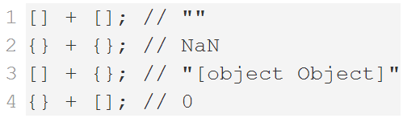
JavaScript Engines
Depends on Browser
V8 in Chrome, Chakra in IE, Spidermonkey in Firefox, JavaScriptCore for Safari, etc.
Services
Memory Management / GC
Just-in-Time Compilation
Type System
etc.

Slide 11
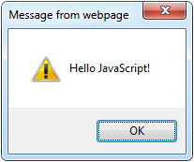
The First Script
<html>
<body>
<script type="text/javascript">
alert('Hello JavaScript!');
</script>
</body>
</html>

Slide 12
First JavaScript
Live Demo

Slide 13
Using JavaScript Code
The JavaScript code can be placed in:
<script> tag in the head
<script> tag in the body - not recommended
External files, linked via <script> tag the head
Files usually have .js extension
Highly recommended
The .js files get cached by the browser
<script src="scripts.js" type="text/javscript">
<!– code placed here will not be executed! -->
</script>

Slide 14
JavaScript – When is Executed?
JavaScript code is executed during the page loading or when the browser fires an event
All statements are executed at page loading
Some statements just define functions that can be called later
No compile time checks
Function calls or code can be attached as "event handlers" via tag attributes
Executed when the event is fired by the browser
<img src="logo.gif" onclick="alert('clicked!')" />

Slide 15
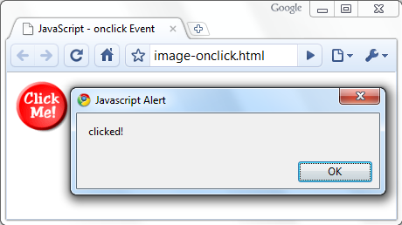
Calling a JavaScript Function from Event Handler – Example
<html>
<head>
<script type="text/javascript">
function test (message) {
alert(message);
}
</script>
</head>
<body>
<img src="logo.gif"
onclick="test('clicked!')" />
</body>
</html>

Slide 16
Event Handlers
Live Demo

Slide 17
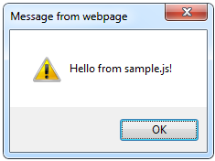
Using External Script Files
Using external script files:
External JavaScript file:
<html>
<head>
<script src="sample.js" type="text/javascript">
</script>
</head>
<body>
<button onclick="sample()" value="Call JavaScript
function from sample.js" />
</body>
</html>
external-JavaScript.html
The <script> tag is always empty.
function sample() {
alert('Hello from sample.js!')
}
sample.js

Slide 18
External JavaScript Files
Live Demo

Slide 19
Node.js
Running JavaScript in a console

Slide 20
Node.js Overview
Node.js is a server-side platform that uses JavaScript
Runs the V8 JS interpretour
Allows creating end-to-end apps with JavaScript
Usable to test & learn JavaScript Syntax

Slide 21
Installing Node.js
Visit the Node.js website: https://nodejs.org/
Next -> Next -> Next -> …
Make sure Node.js is added to PATH
Node.js is installed on the machine and can be used through the CMD/Terminal
In the CMD/Terminal run "node –v"
Should return the version, if node is installed and working

Slide 22
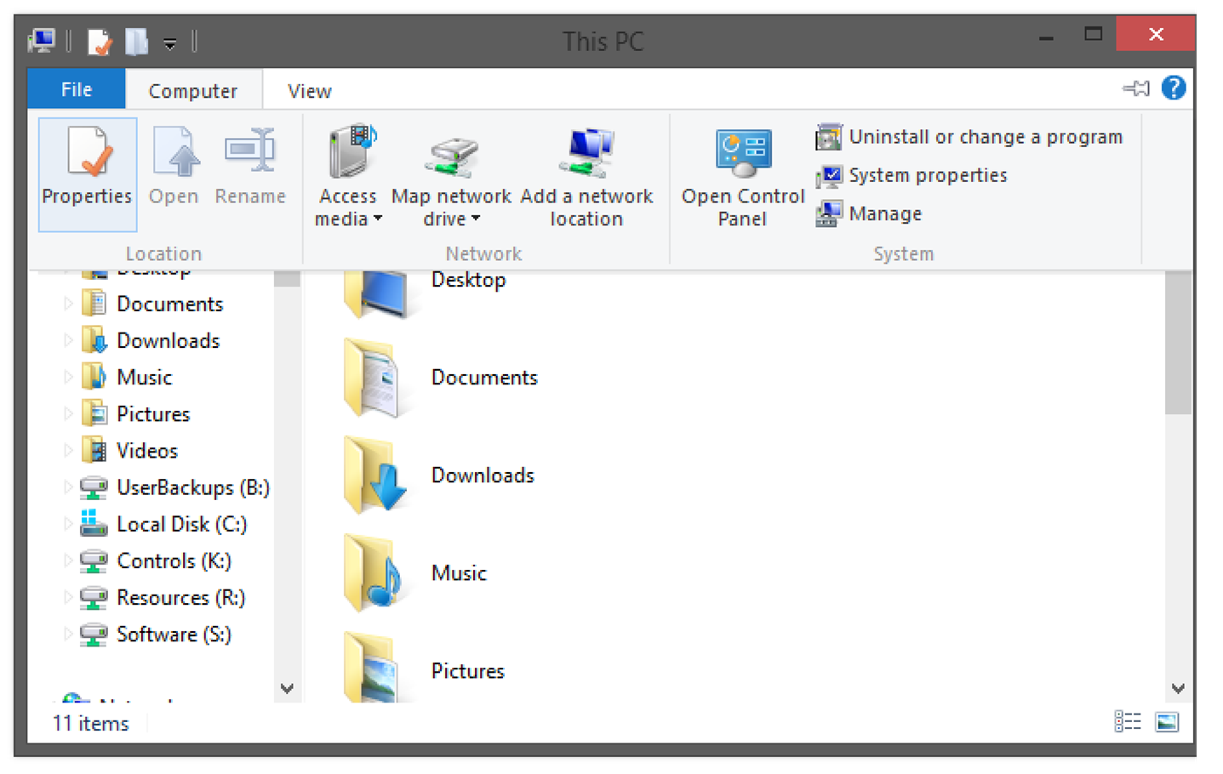
Adding Node.js to Path on Windows (1)
Go to "Computer" -> "Properties"

Slide 23
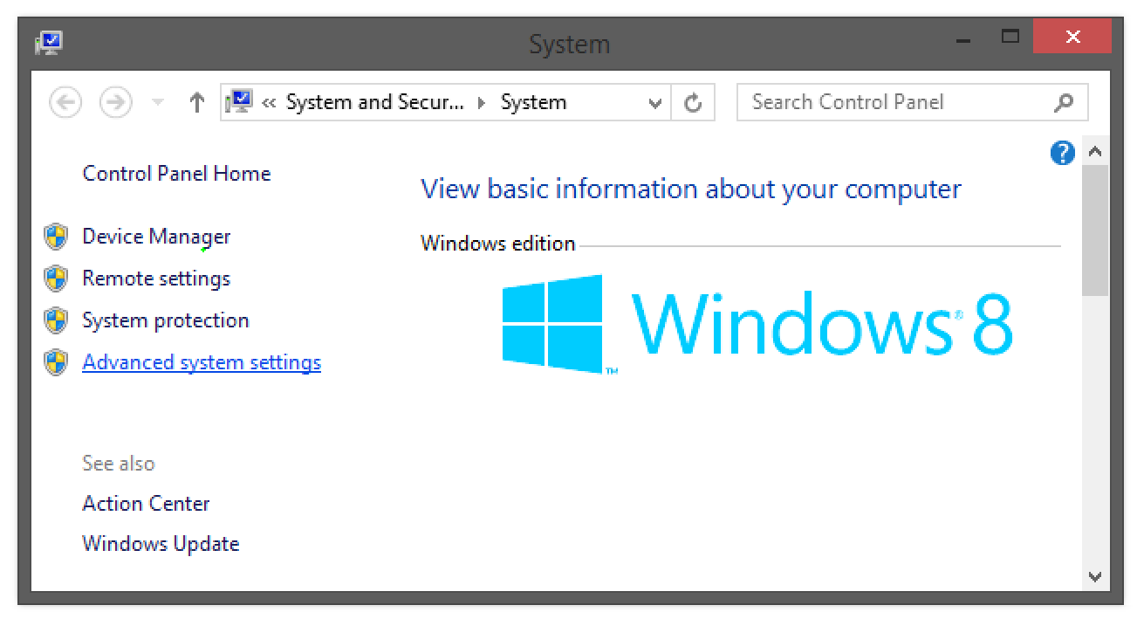
Adding Node.js to Path on Windows (2)
Go to "Advanced system settings"

Slide 24
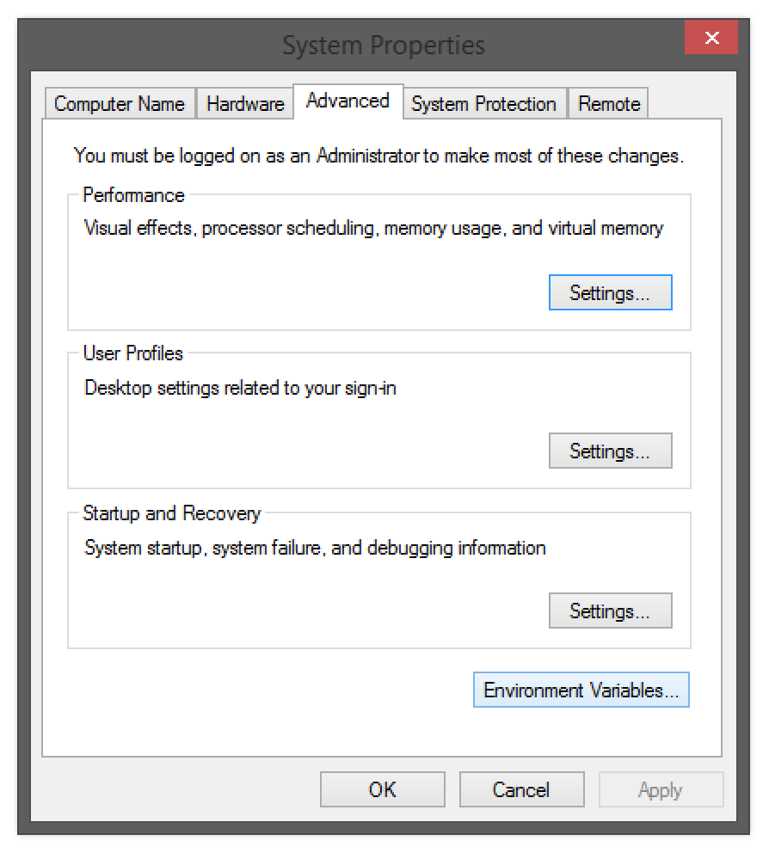
Adding Node.js to Path on Windows (3)
Go to "Advanced" -> "Environment Variables"

Slide 25
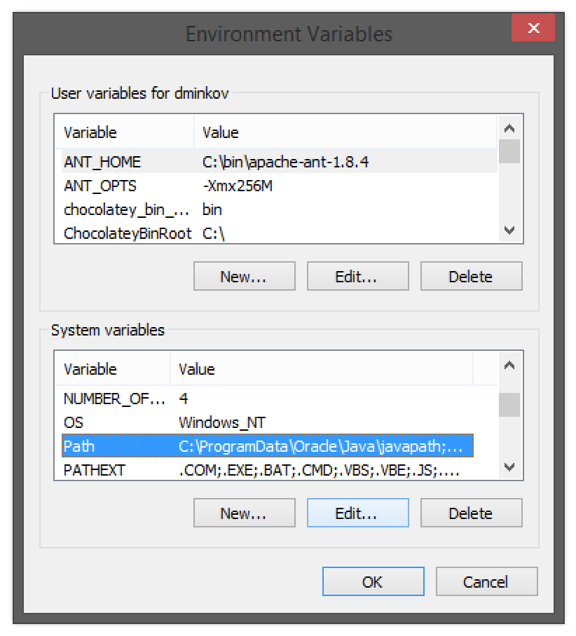
Adding Node.js to Path on Windows (4)
Go to "System Variables" -> "Path" -> "Edit"

Slide 26
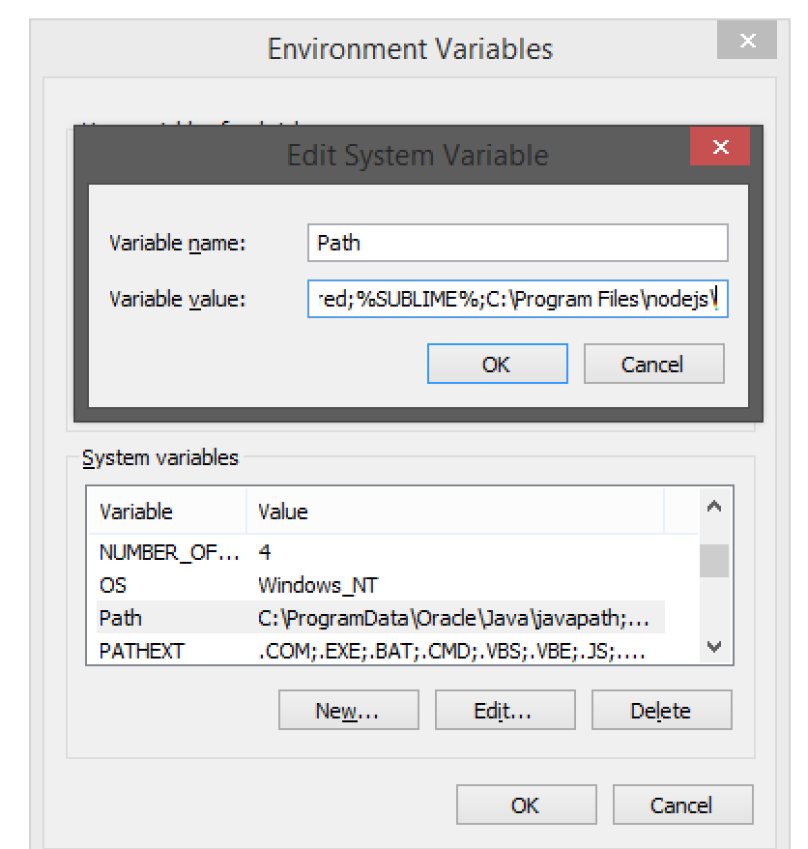
Adding Node.js to Path on Windows (5)
Add to the end:
;C:\Program Files\nodejs\

Slide 27
Adding Node.js To Path on Windows
Live Demo

Slide 28
Adding Node.js to Path on Linux and OS X
Open ~/.bashrc with admin sudo
Find the Node.js path
Usually it is "/usr/bin/node"
Add the Node.js path to ~/.bashrc
You have Node.js in the PATH
PATH=/usr/bin/node:$PATH

Slide 29
Adding Node.js to Path on OS X & Linux
Live Demo

Slide 30
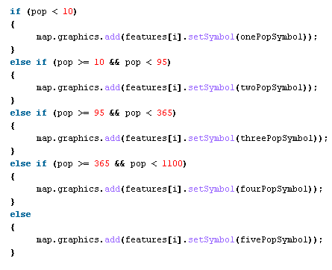

The JavaScript Syntax

Slide 31
JavaScript Syntax
The JavaScript syntax is similar to C#
Operators (+, *, =, !=, &&, ++, …)
Variables (typeless)
Conditional statements (if, else)
Loops (for, while)
Arrays (my_array[]) and associative arrays (my_array['abc'])
Functions (can return value)

Slide 32
Standard Popup Boxes
Alert box with text and [OK] button
Just a message shown in a dialog box:
Confirmation box
Contains text, [OK] button and [Cancel] button:
Prompt box
Contains text, input field with default value:
alert("Some text here");
confirm("Are you sure?");
prompt ("enter amount", 10);

Slide 33
Popup Boxes
Live Demo

Slide 34

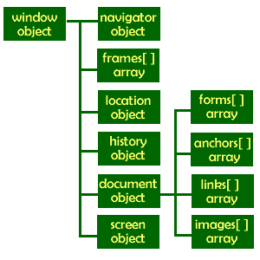
The Built-In Browser Objects

Slide 35
Built-in Browser Objects
The browser provides some read-only data via:
window
The top node of the DOM tree
Represents the browser's window
document
holds information the current loaded document
screen
Holds the user’s display properties
browser
Holds information about the browser

Slide 36
DOM Hierarchy – Example
window
navigator
screen
document
history
location
form
form
button
form

Slide 37
Other JavaScript Objects

Slide 38
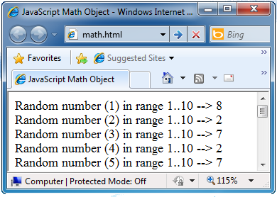
The Math Object
The Math object provides some mathematical functions
for (i=1; i<=20; i++) {
var x = Math.random();
x = 10*x + 1;
x = Math.floor(x);
document.write(
"Random number (" +
i + ") in range " +
"1..10 --> " + x +
"<br/>");
}

Slide 39
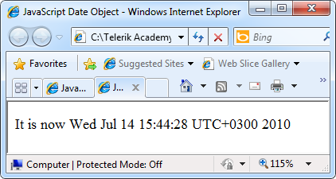
The Date Object
The Date object provides date / calendar functions
var now = new Date();
var result = "It is now " + now;
document.getElementById("timeField")
.innerText = result;
...
<p id="timeField"></p>

Slide 40
Timers: setTimeout()
Make something happen (once) after a fixed delay
var timer = setTimeout(bang, 5000);
5 seconds after this statement executes, this function is called
clearTimeout(timer);
Cancels the timer

Slide 41
Timers: setInterval()
Make something happen repeatedly at fixed intervals
var timer = setInterval(clock, 1000);
This function is called continuously per 1 second.
clearInterval(timer);
Stop the timer.

Slide 42
Timer – Example
<script type="text/javascript">
function timerFunc() {
var now = new Date();
var hour = now.getHours();
var min = now.getMinutes();
var sec = now.getSeconds();
document.getElementById("clock").value =
"" + hour + ":" + min + ":" + sec;
}
setInterval(timerFunc, 1000);
</script>
<input type="text" id="clock" />

Slide 43
Other JavaScript Objects
Live Demo

Slide 44

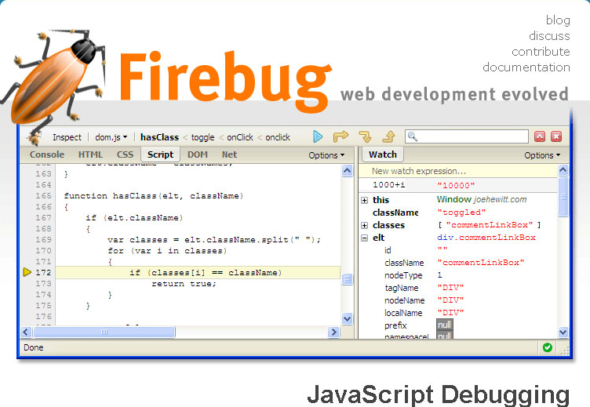
Debugging JavaScript

Slide 45
Debugging JavaScript
Modern browsers have JavaScript console where errors in scripts are reported
Errors may differ across browsers
Several tools to debug JavaScript
Microsoft Script Editor
Add-on for Internet Explorer
Supports breakpoints, watches
JavaScript statement debugger; opens the script editor

Slide 46
Firebug
Firebug – Firefox add-on for debugging JavaScript, CSS, HTML
Supports breakpoints, watches, JavaScript console editor
Very useful for CSS and HTML too
You can edit all the document real-time: CSS, HTML, etc
Shows how CSS rules apply to element
Shows Ajax requests and responses
Firebug is written mostly in JavaScript

Slide 47
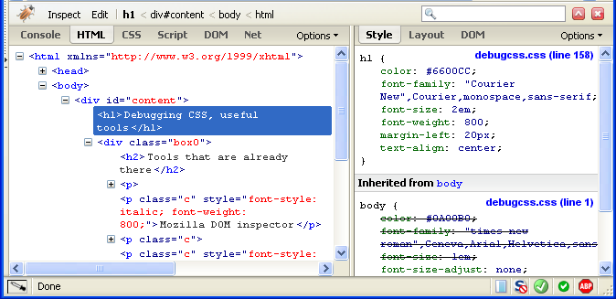
Firebug (2)

Slide 48
Debugging JS in the Browser
Live Demo

Slide 49
Debugging Node.js
JavaScript can also be debugged with Node.js:
Open Terminal/CMD
Run
In CMD/Terminal, navigate to the folder of the file to debug
Run in
A browser opens with the code, and it can be debugged
$ npm install –g node-inspector
$ node-debug FILE_TO_DEBUG

Slide 50
Debugging Node.js
Live Demo

Slide 51
JavaScript Console Object
The console object exists only if there is a debugging tool that supports it
Used to write log messages at runtime
Methods of the console object:
debug(message)
info(message)
log(message)
warn(message)
error(message)

Slide 52
Introduction JavaScript Development
?
?
?
?
?
Questions?
?
?
?
?
?
?

Slide 53
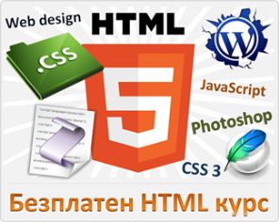



Free Trainings @ Telerik Academy
"Web Design with HTML 5, CSS 3 and JavaScript" course @ Telerik Academy
html5course.telerik.com
Telerik Software Academy
academy.telerik.com
Telerik Academy @ Facebook
facebook.com/TelerikAcademy
Telerik Software Academy Forums
forums.academy.telerik.com

